Slide 1
Integrating Factor
In general,
Equation M(x, y)dx + N(x, y)dy = 0 is not exact.
Occasionally, it is possible to transform
M(x, y)dx + N(x, y)dy = 0
into an exact differential equation by a judicious multiplication.
A function I(x, y) is an integrating factor for
M(x, y)dx + N(x, y)dy = 0
if the equation
I(x, y)[M(x, y)dx + N(x, y)dy] = 0 is exact.
A solution to M(x, y)dx + N(x, y)dy = 0
is obtained by solving the exact differential
equation defined by
I(x, y)[M(x, y)dx + N(x, y)dy] = 0

Slide 2
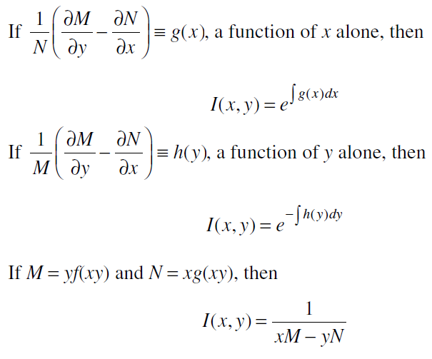
SPECIAL CONDITIONS:-

Slide 3
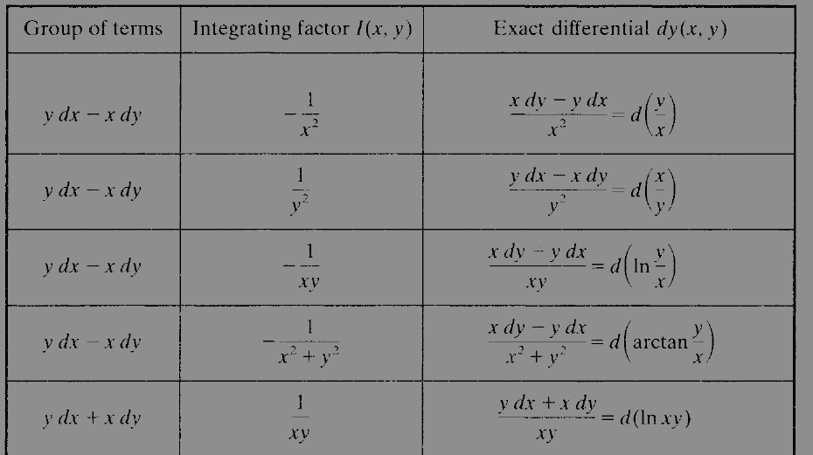
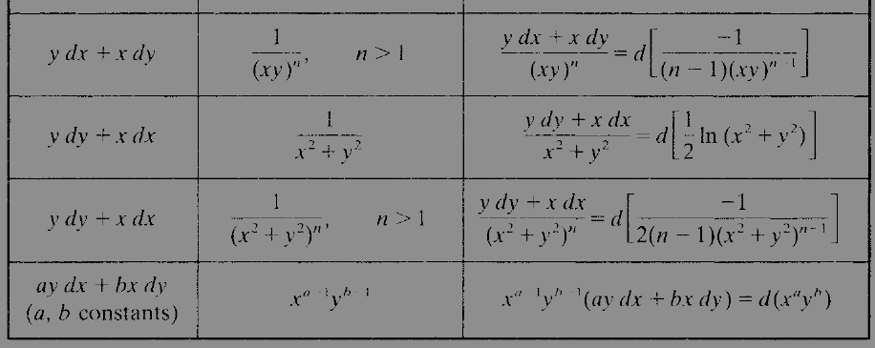

Slide 4

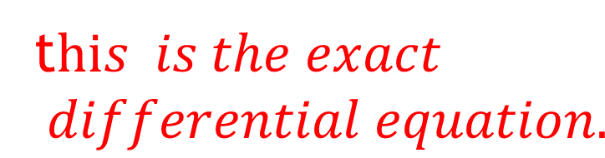


Examples
Determine whether the differential equation ydx − xdy = 0 is exact.
Solution:- M (x, y) = y, N (x, y) = −x.
which are not equal, so the differential equation is not exact.

Slide 5
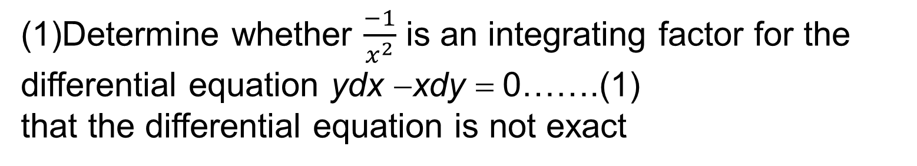




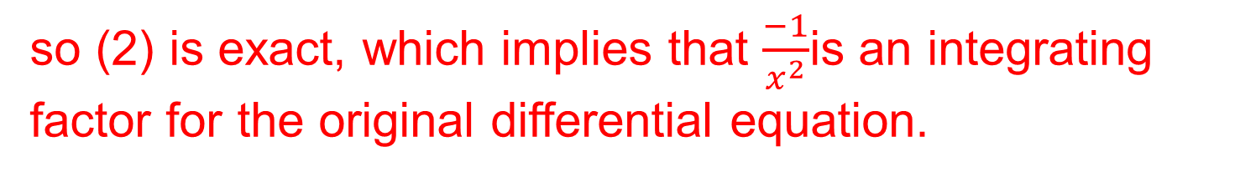
Examples
Examples
…..(2)

Slide 6

Examples
2
Solve ydx − xdy = 0.
which is exact
can be rewritten as
d (y/x) = 0. Hence, by direct integration, we have y / x = c, or y = xc, as

Slide 7


Linear differential Equation
A first-order linear differential equation has the form
y′ + p(x)y = q(x)
An integrating factor for Equation
M(x, y)dx + N(x, y)dy = 0 is
The general solution for Equation
y′ + p(x)y = q(x) is
where c is the constant of integration

Slide 8

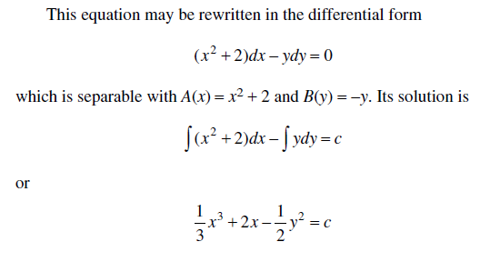
Examples
solution

Slide 9




Examples
with p(x) = 4 / x
Integrating factor
General solution

Slide 10

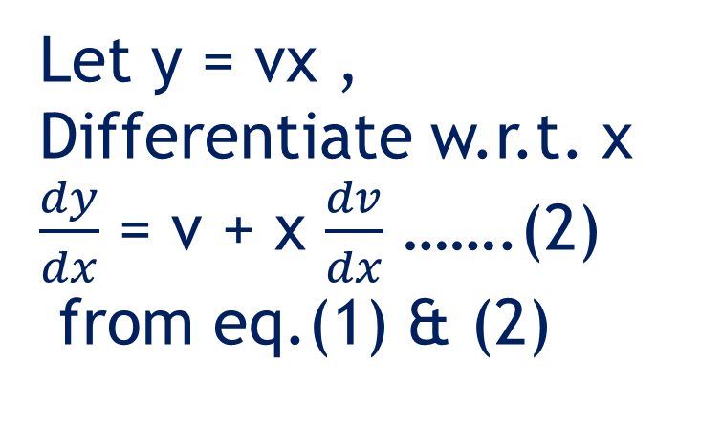
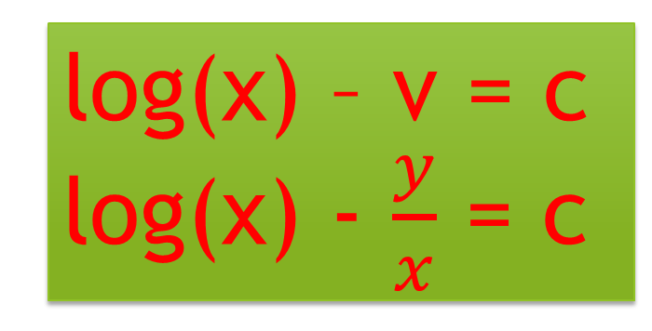



Examples of homogeniuos equation
………..(1)

Slide 11


Bernoulli Equations
A Bernoulli differential equation has
the form
where n is a real number.
The substitution
Transforms
into a linear differential equation in the unknown function z(x).

Slide 12
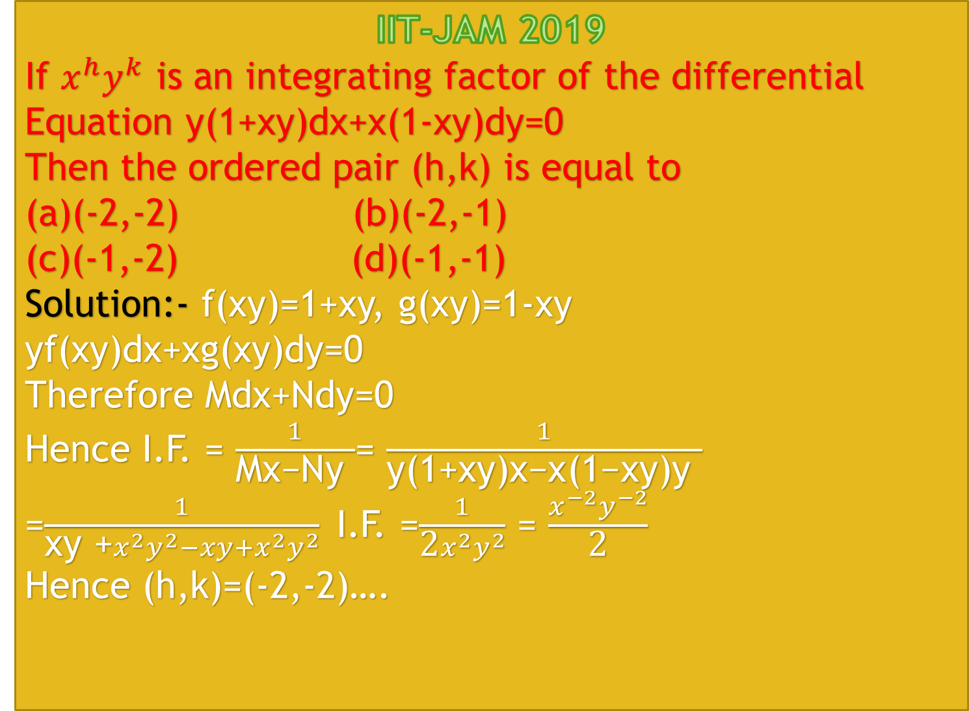

Slide 13
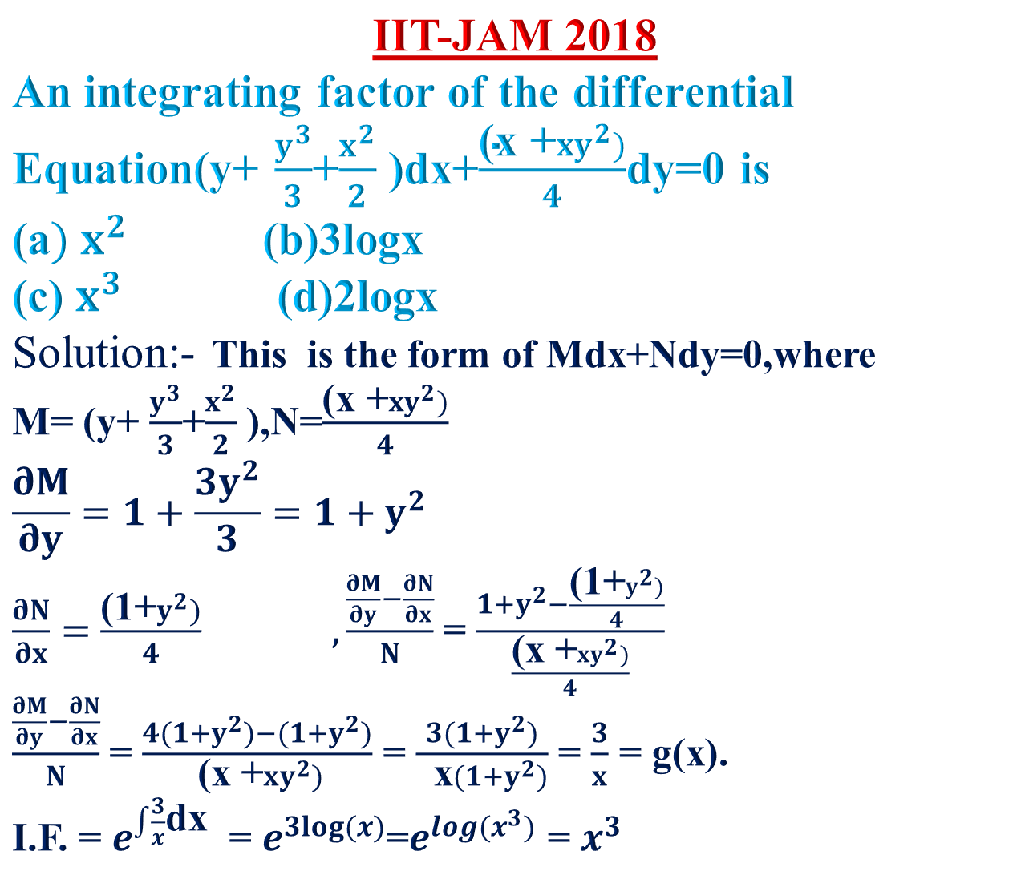

Slide 14
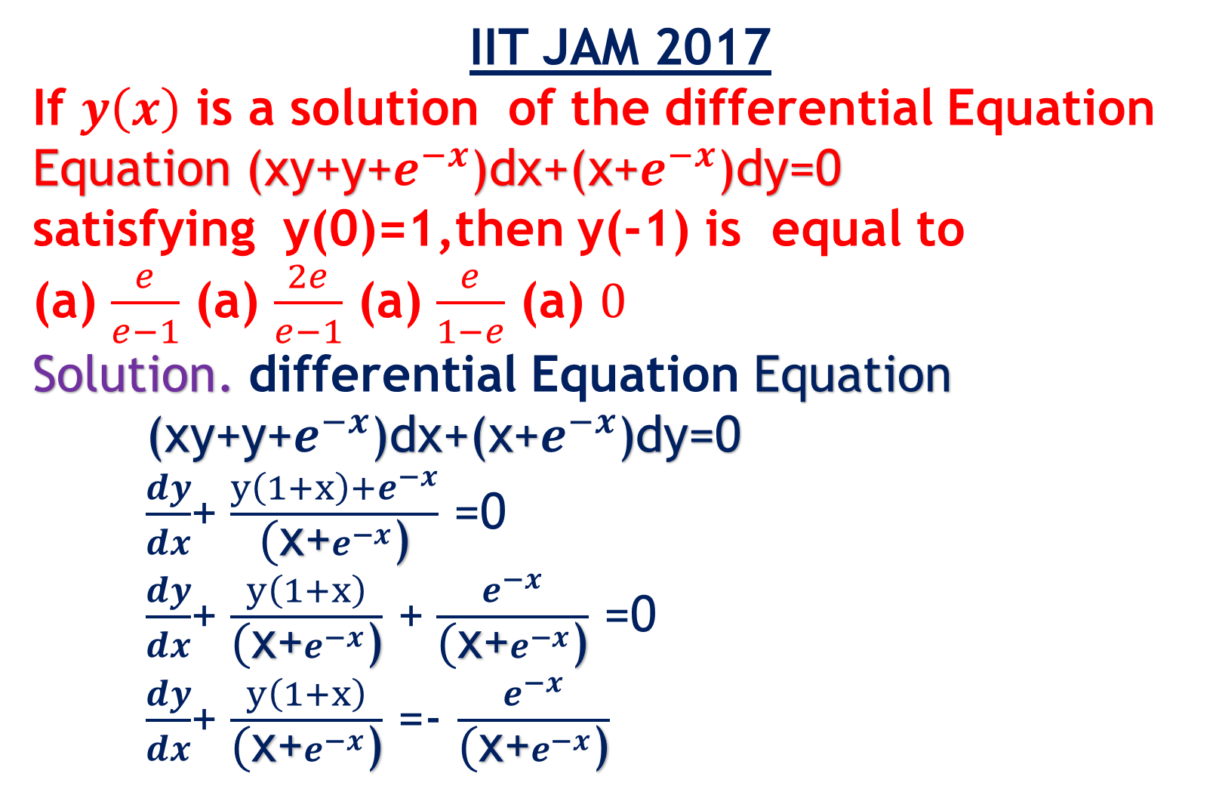

Slide 15
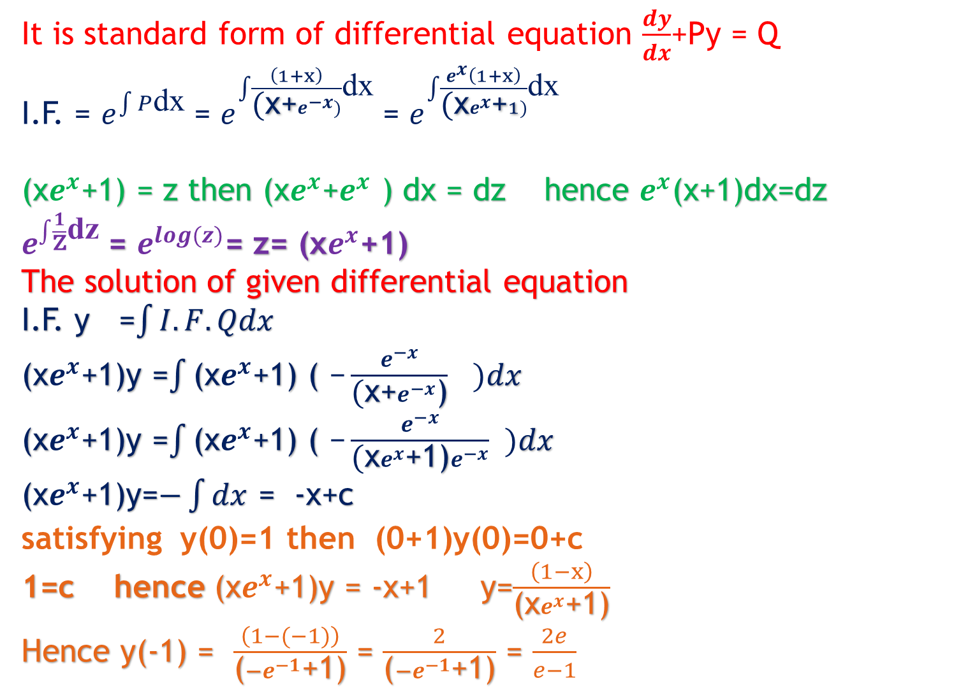

Slide 16
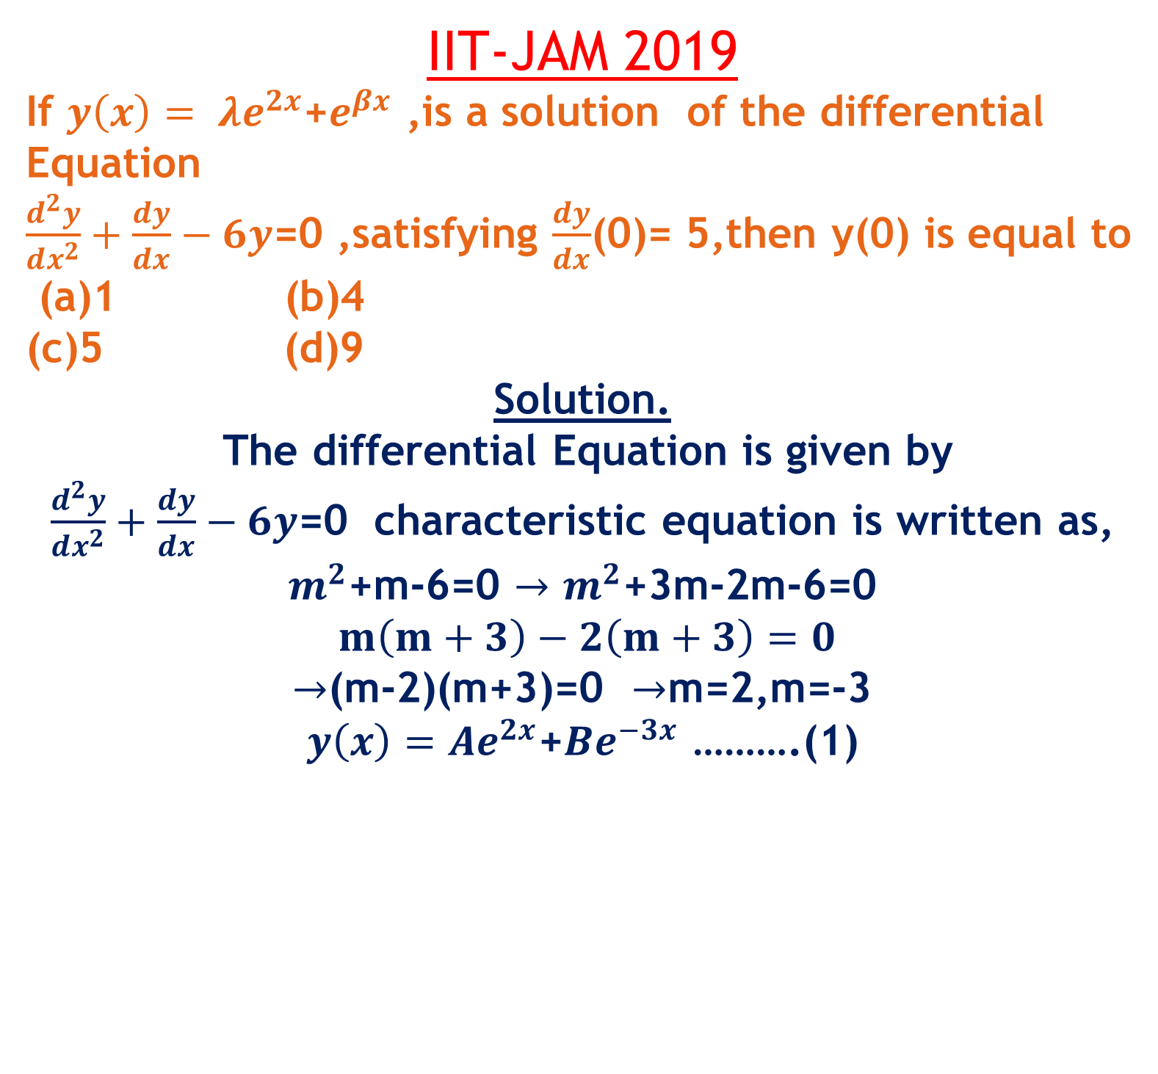

Slide 17
